Slide 1
24/7 Gardener
An IOT Project.
20027865.
TJ Fitzpatrick.

Slide 2
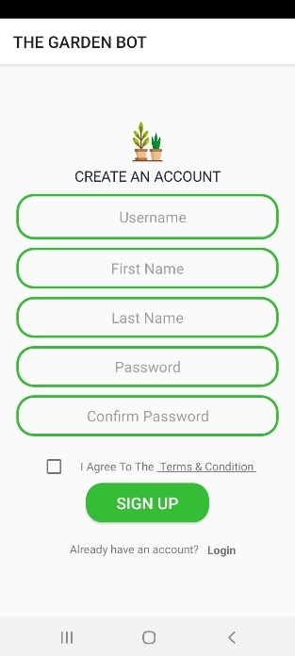
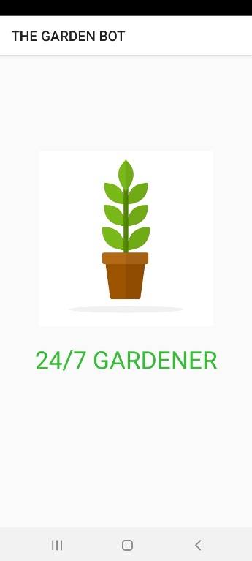
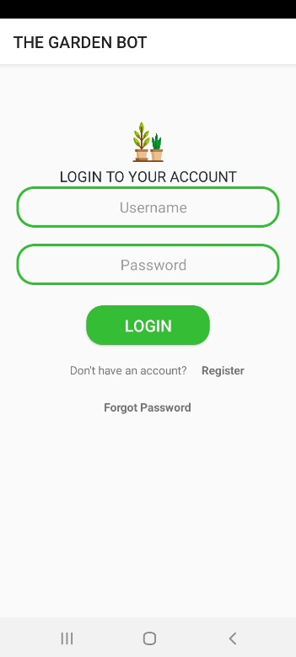
Introduction.
Introduction.
Acknowledgement.
Background.

Slide 3
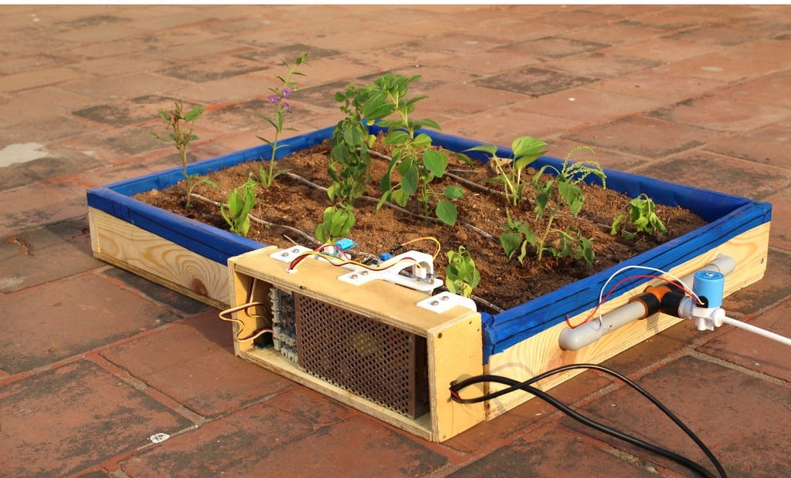
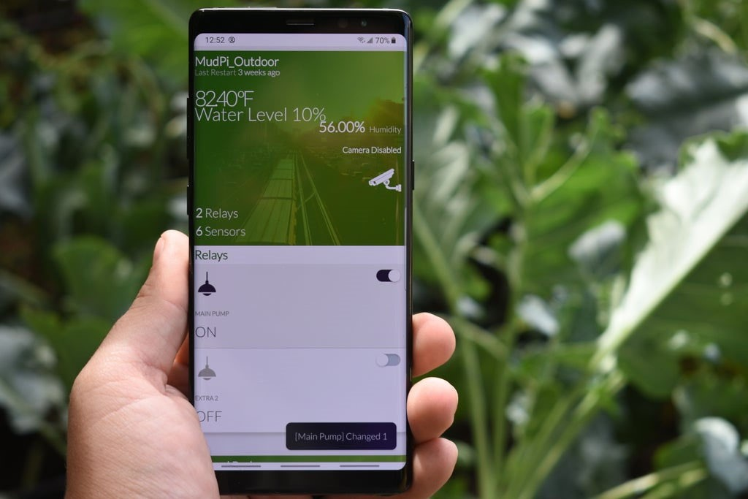
Research.
Online Literature.
Mythology.

Slide 4
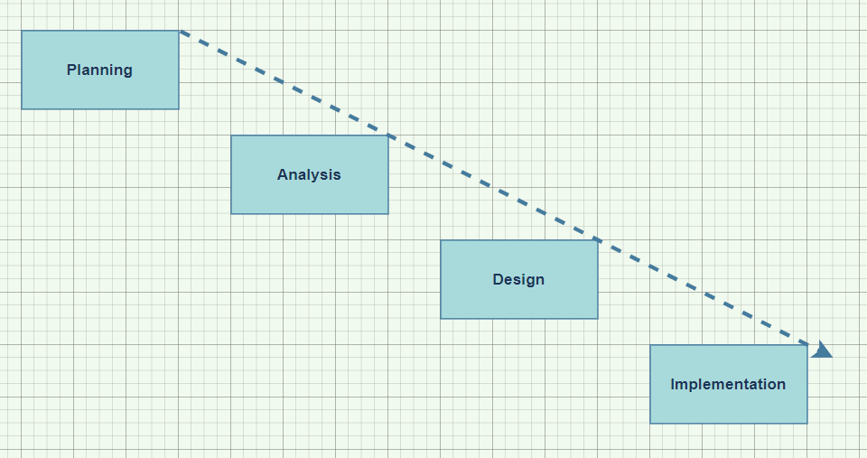
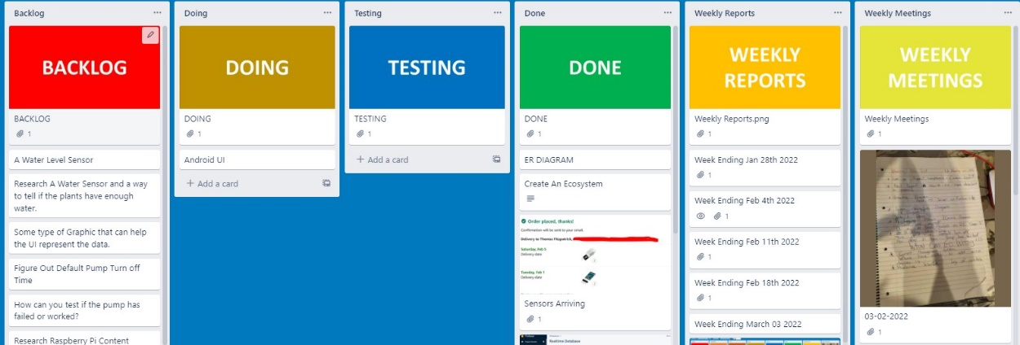
Proposal And Specification.
Proposal
List of Technologies.
Development Life Cycle .
Specification
Technology Evaluation.
Management.

